Slide 1
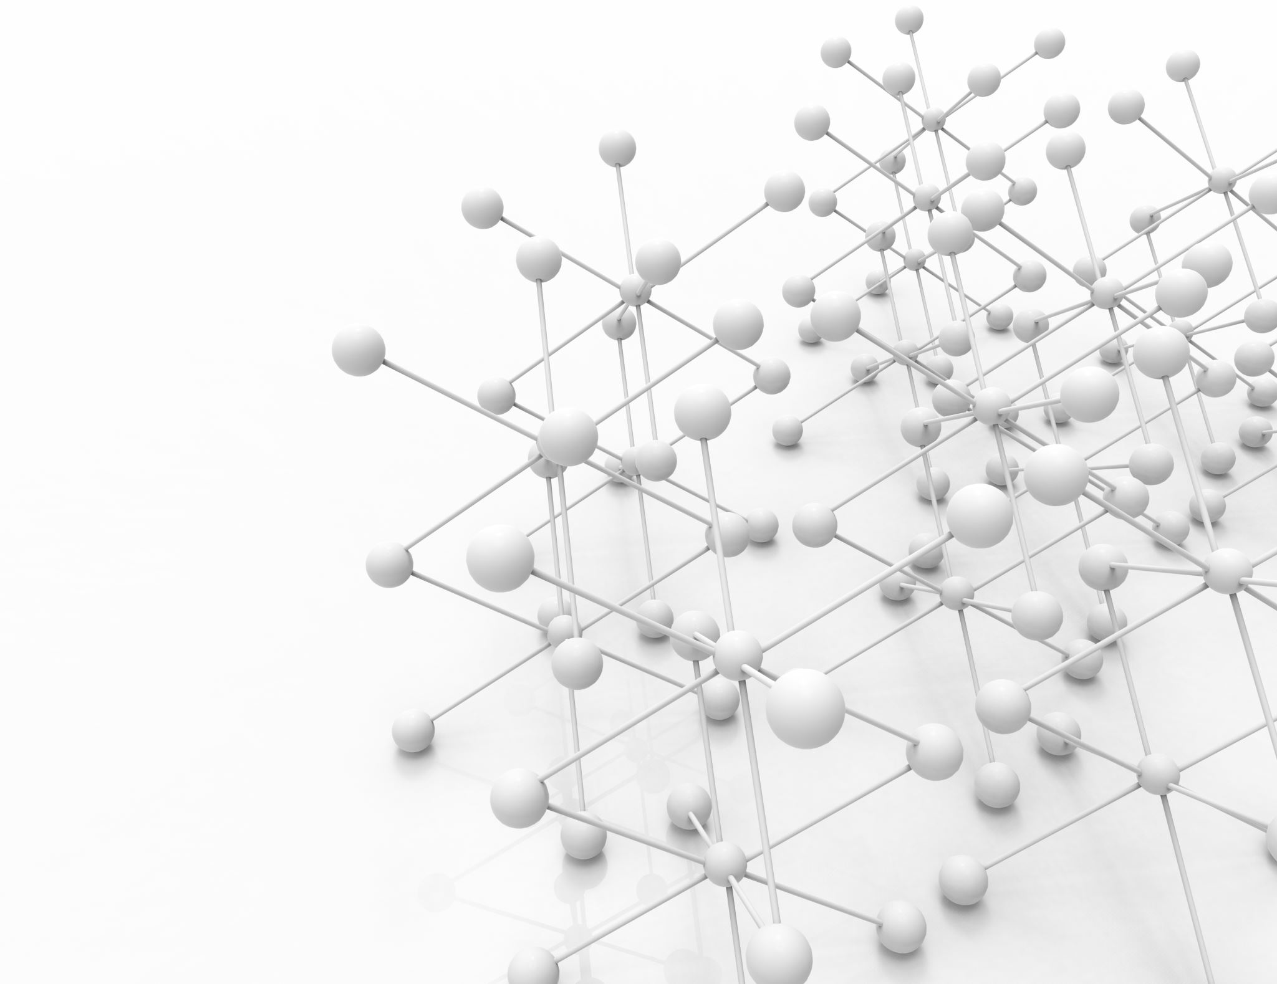

Data Mining Project 2 Decision Trees & Neural Network Classification
Link → Collab Notebook
Nash Morrison
[Team 13]

Slide 2
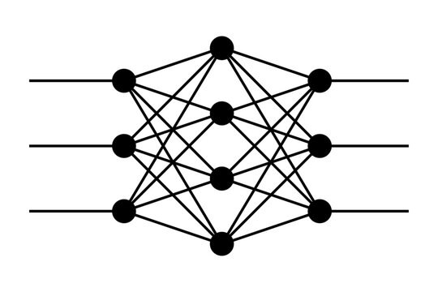
Effort, Roles & Timeline
Python
20+ Hours R&D
5+ Hours on PowerPoint Presentation
Youtube
Crafted By Nash
Notes:
1 slide overview of efforts (be specific: team member roles/parts, ...)

Slide 3
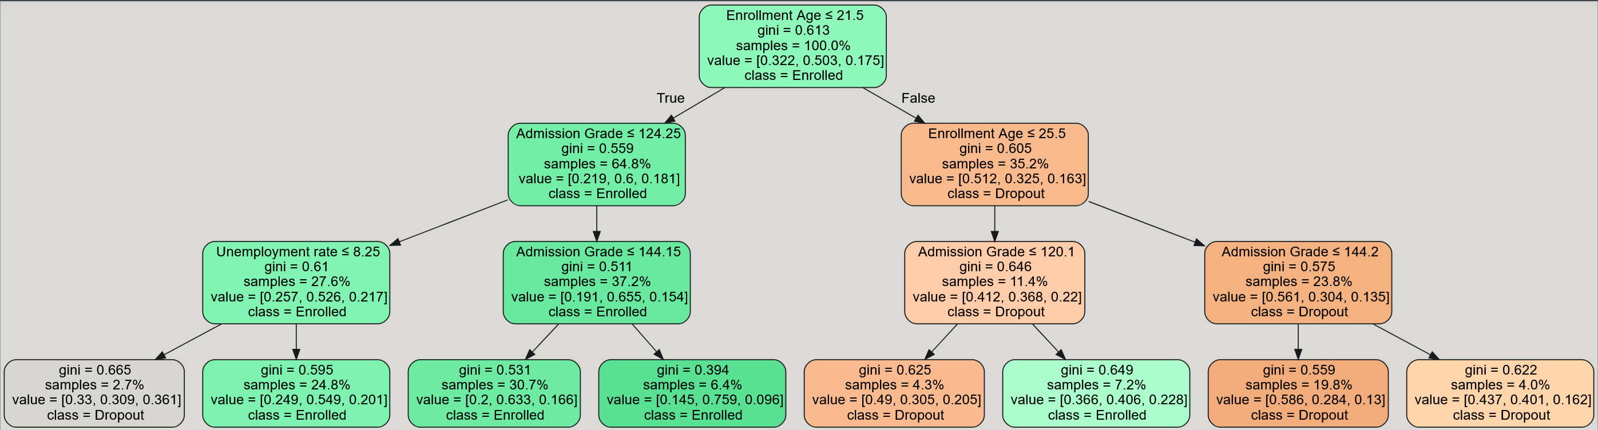
The Data
Predict Students' Dropout and Academic Success Dataset
4424 Rows x 37 Columns
Two Datasets w/ Pandas
Attributes → [Admission Grade, Enroll Age, Unemployment]
Target → [Dropout, Enrolled, Graduate]
Attribute Data Types → float64
Target Data Types → int64 [0, 1, 2]
NumPy Array Conversions
Notes:
1 slide for data Description and Visualizations. Make sure to be clear on what is the dataset (1 sentence), number of records, labels (what they represent), important attributes and types etc. Mention what you did to the data if you did anything, e.g. eliminated columns or records, discretized attributes, used scaling, etc. Please refer to Project1 instructions and template for what type of visualization or plots you could have for the data you are using. - It should be very clear what the data contains and what you are predicting, again brief succinct statements

Slide 4
Architecture
Decision Tree
Gini Index
Random State: 75-Test / 100 Gini
Min Leaf Samples: 2
Min Sample Split: 3
Max Depth: 3
Test Size: 0.2
Random State: 200-Test / 200 Gini
Min Leaf Samples: 4
Max Depth: 4
Test Size: 0.3
Entropy
Random State: 75-Test / 175 Ent.
Min Leaf Samples: 2
Min Sample Split: 3
Max Depth: 3
Test Size: 0.2
Random State: 200-Test / 200 Ent.
Min Leaf Samples: 4
Max Depth: 4
Test Size: 0.3
Neural Network Optimizers
Adam
Test (1)
Layers: 3
Neurons [16,32,64]
Init Learn Rate 0.01
Random State 200
Epochs 60
SGD
Test (1)
Layers: 4
Neurons [2,4,8,16]
Init Learn Rate 0.04
Random State 150
Epochs 350
Momentum 0.3
Test (2)
Layers: 5
Neurons [8,16,32,64,128]
Random State 100
Epochs 100
Momentum 0.1
Test (2)
Layers: 4
Neurons [2,4,8,16]
Random State 100
Epochs 150
Notes:
1 slide with decision tree and neural network(s) summary: model “architecture(s)” or "configurations" you utilized and list of hyperparameters and values you explored. Model e.g. MLP, how many layers, neurons, etc. Hyperparameters to optimize: Number of Epochs, Learning Rate, Number of Neurons, Hidden Layers, …
Here you do not show any results, but a list of the above for what your group did try
If the values are too many, you could list a range of values or use a summary e.g. “5 values”

Slide 5
Decision Tree Results
Gini Report 1 | Precision | Recall | F1-Score | Support
Dropout | 52.87% | 46.07% | 49.24% | 280
Enrolled | 55.76% | 79.02% | 65.38% | 429
Graduate | 24.24% | 4.55% | 7.66% | 176
Accuracy |  |  | 53.79% | 885
Macro Avg | 44.29% | 43.21% | 40.76% | 885
Wtd. Avg | 48.58% | 53.79% | 48.79% | 885
Gini 1 → 0.394
Samples → 6.4%
Class → Enrolled
Gini Report 2 | Precision | Recall | F1-Score | Support
Dropout | 50.24% | 47.80% | 48.99% | 431
Enrolled | 56.38% | 77.32% | 65.21% | 657
Graduate | 11.76% | 0.83% | 1.56% | 240
Accuracy |  |  | 53.92% | 1328
Macro Avg | 39.46% | 41.98% | 38.59% | 1328
Wtd. Avg | 46.33% | 53.92% | 48.44% | 1328
Gini 2 → 0.0
Samples → 0.4%
Class → Enrolled
Entropy Report 1 | Precision | Recall | F1-Score | Support
Dropout | 52.85% | 46.43% | 49.43% | 280
Enrolled | 55.56% | 78.09% | 64.92% | 429
Graduate | 27.78% | 5.68% | 9.43% | 176
Accuracy |  |  | 53.67% | 885
Macro Avg | 45.39% | 43.40% | 41.26% | 885
Wtd. Avg | 49.17% | 53.67% | 48.99% | 885
Entropy Report 2 | Precision | Recall | F1-Score | Support
Dropout | 50.60% | 48.72% | 49.65% | 431
Enrolled | 56.49% | 76.86% | 65.12% | 657
Graduate | 10.53% | 0.83% | 1.54% | 240
Accuracy |  |  | 53.99% | 1328
Macro Avg | 39.21% | 42.14% | 38.77% | 1328
Wtd. Avg | 46.27% | 53.99% | 48.61% | 1328
Entropy 1 → 1.584 Samples → 2.9%
Class → Dropout
Entropy 2 →1.566
Samples → 2.0%
Class → Enrolled
Notes:
2 slides with results from neural network experimentation vs. decision tree result. Any results should be in tables and/or plots as applicable. For example, if you add layers did accuracy increase? What happens when you train the network “more” (iterations / epochs)? …
These are just ideas, it is up to the group to show effort and creativity.
Remember, this needs to show thought and you must "tell a story", not simply show different results.
Other things you can state / make clear: did you report only accuracy or other metrics? a single train-test split (show percentages) OR cross validation? etc.

Slide 6
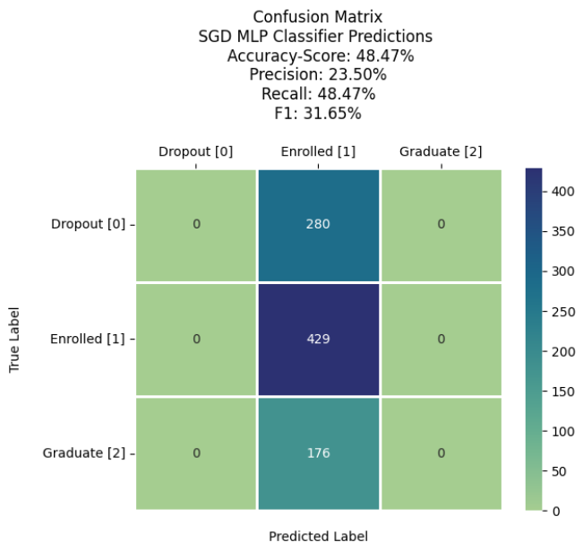
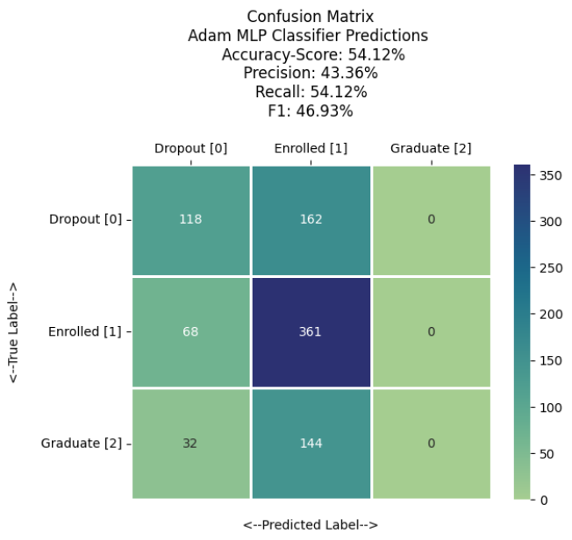
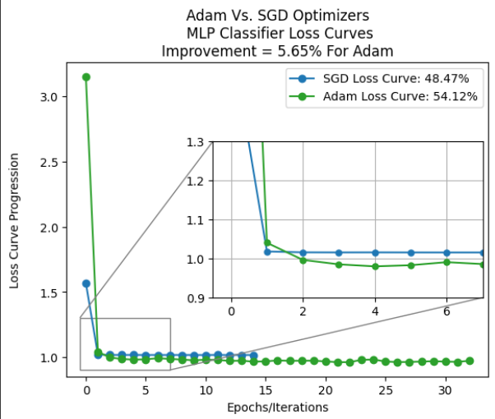
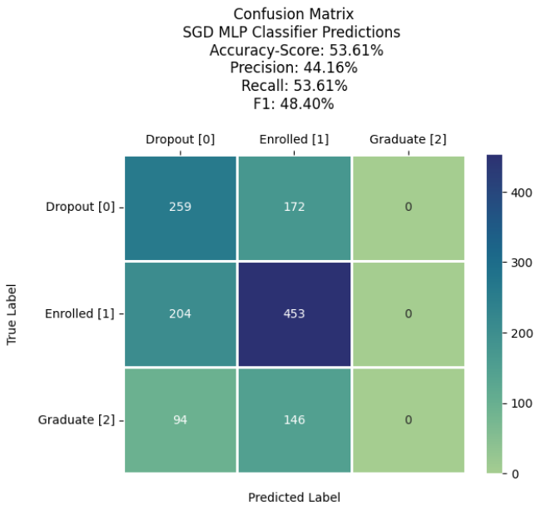
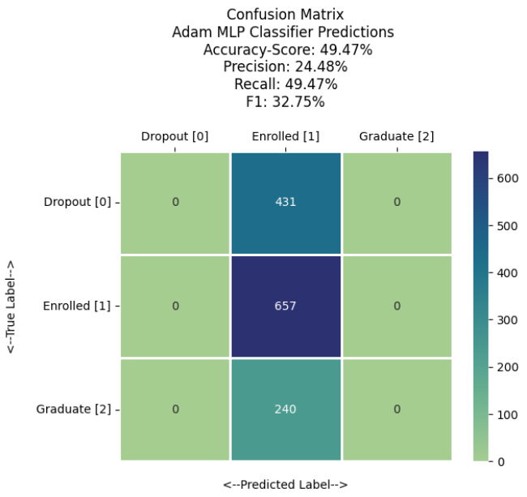
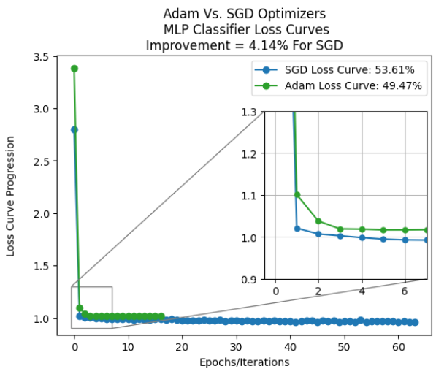
Neural Network Results
Notes:
2 slides with results from neural network experimentation vs. decision tree result. Any results should be in tables and/or plots as applicable. For example, if you add layers did accuracy increase? What happens when you train the network “more” (iterations / epochs)? …
These are just ideas, it is up to the group to show effort and creativity.
Remember, this needs to show thought and you must "tell a story", not simply show different results.
Other things you can state / make clear: did you report only accuracy or other metrics? a single train-test split (show percentages) OR cross validation? etc.

Slide 7
Conclusions
Decision Trees
Gini Index Scores: Lower → Better Indication of Classes
Gini 1: 0.394, classifying 6.4% of samples as Enrolled.
Gini 2: 0.0, indicating perfect separation; 0.4% of samples as Enrolled.
Entropy Scores: Higher → More Mixed Classes.
Entropy 1: 1.584, classifying 2.9% of samples as Dropout.
Entropy 2: 1.566, classifying 2.0% of samples as Enrolled.
Decision Trees provided interpretable splits; struggled with under-represented classes like Graduate.
Neural Networks
Adam (1) → 54.12% outperformed Decision Trees → 53.99% @ peak with handling imbalanced target classes and numerical attributes.
Rigorous testing & fine-tuning to improve accuracy.
Confusion Matrices
True Positives: Successfully classified Dropout = 0, Enrolled = 1, Graduate = 2.
Misclassifications: High confusion between Dropout and Enrolled, showing bias in minority classes.
No classifications for Graduate.
Future Improvements
Address class imbalances (Graduate) to improve predictions.
More Attributes
More Fine-tuning of hyperparameters to better enhance predictive accuracy.
Notes:
1 slide summarized conclusions: again short statements, summarize observations and conclusions. E.g. which model performed the best? IF something was incomplete or not done correctly or has issues etc. please briefly mention here.

Slide 8

Thank You! Questions? Comment Down Below
Notes:
End with “Thank you/questions” slide

